Slide 1
Lecture 12
Permutations and Combinations
CSCI – 1900 Mathematics for Computer Science
Fall 2014
Bill Pine

Slide 2
Lecture Introduction
Reading
  Rosen - Section 6.1
Learning to count sequences under four situations:
  Order matters, duplicates allowed
  Order matters, no duplicates allowed
  Any order, no duplicates allowed
  Any order, duplicates allowed

Slide 3
Sequences Derived from a Set
Assume we have a set A containing n items
Examples include alphabet, decimal digits, playing cards, …
We can produce sequences from each of these sets
Example
  R, a, g, l, a, n, , R, o, a, d
  A♣, A♠, 8♣, 8♠, Q♣

Slide 4
Types of Sequences from a Set
If we classify by order and duplications, 4 cases:
  Order matters, duplicates allowed
  Order matters, duplicates not allowed
  Order doesn’t matter, duplicates not allowed
  Order doesn’t matter, duplicates allowed

Slide 5
Classifying Real-World Sequences
Determine the set, size of set, and classify each of the following as one of the previously listed types of sequences
Blackjack Hands
Phone numbers
Lottery numbers
Binary numbers
Windows XP CD
Key
Votes in a
presidential election
Selecting from a limited menu for awards dinner

Slide 6
Order Matters
Duplicates Are Allowed

Slide 7

Multiplication Principle of Counting
Supposed that two items I₁ and I₂ appear in that order
  If for I₁ there are n₁ possible choices for a value
  If for I₂ there are n₂ possible choices for a value
Then the sequence I₁I₂ can have $n_{1}∗n_{2}$ possible values

Slide 8

Multiplication Principle (continued)
Extended previous example to I₁, I₂, …, I_{k}
Solution is $n_{1}∗n_{2}∗…∗n_{k}$

Slide 9
Examples of Multiplication Principle
8 character passwords
  First digit must be a letter
  Any character after that can be a letter or a number
  26*36*36*36*36*36*36*36 = 2,037,468,266,496
Windows XP/2000 software keys
  Sequence of 25 characters (letters or numbers)
  36²⁵

Slide 10
More Examples
License plates of the form “123-ABC”:
  10*10*10*26*26*26 = 17,576,000
Phone numbers of the form (423) 555-1212
  Under the constraints
    Three digit area code cannot begin with 0
    Three digit exchange cannot begin with 0
  9*10*10*9*10*10*10*10*10*10 = 8,100,000,000

Slide 11
Order Matters
Duplicates Are Not Allowed

Slide 12
Permutations
Assume A is a set of n elements
Suppose we want to make a sequence, S, of length r where 1 < r < n

Slide 13
Permutations(cont)
Because repeated elements are not allowed, how many different sequences can we make?
Process:
  The first selection, I₁, provides n choices
  Each subsequent selection is from a set containing one less element than for the previous selection
  The last choice, I_{r}, has n – (r – 1) = n – r + 1 choices
  This gives us n⋅(n – 1)⋅(n – 2)⋅…⋅(n – r + 1)

Slide 14
Permutations(cont)
Notation: _{n}P_{r} is called number of permutations of n objects taken r at a time
Example: How many 4 letter words can be made from the letters in “Gilbreath” without duplicate letters?
₉P₄ = 9⋅8⋅7⋅6 = 3,024
Example: How many 4-digit PINs can be created for a 5 button door locks?
₅P₄ = 5⋅4⋅3⋅2 = 120

Slide 15
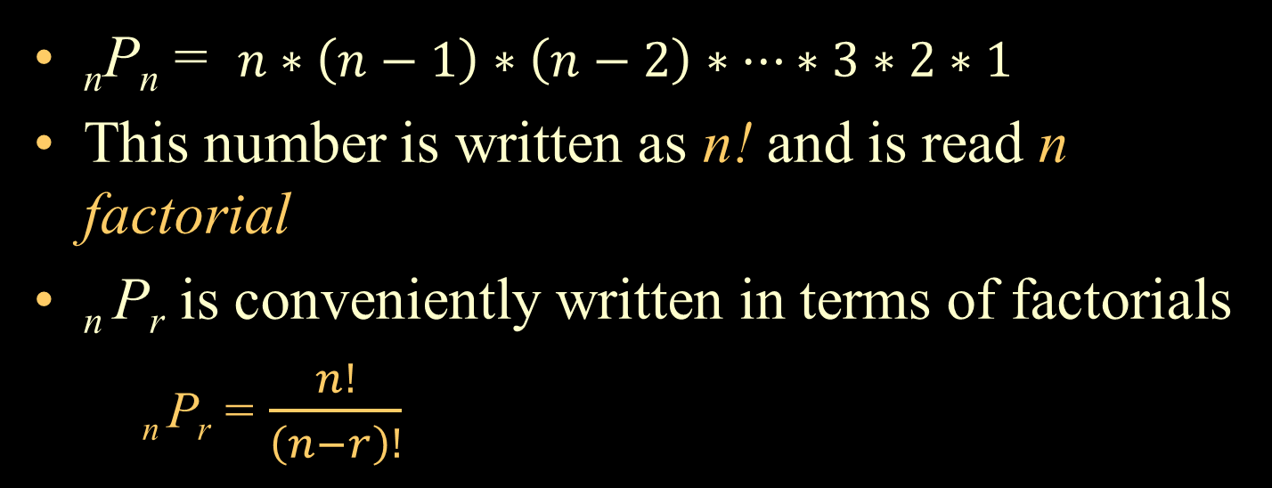
Factorial
_{n}P_{n} = $n∗\left(n−1\right)∗\left(n−2\right)∗…∗3∗2∗1$
This number is written as n! and is read n factorial
_{n} P_{r} is conveniently written in terms of factorials
  _{n} P_{r} = $\frac{n!}{\left(n−r\right)!}$

Slide 16
Distinguishable Permutations
If the set from which a sequence is being derived has duplicate elements, e.g., {a, b, d, d, g, h, r, r, r, s, t}, then straight permutations will actually count some sequences multiple times
Example: How many distinguishable words can be made from the letters in Crusher?
Problem: the r’s cannot be distinguished, e.g.,
  Crusher: = cure is indistinguishable from
  Crusher: = cure

Slide 17
Distinguishable Permutations (cont)
Number of distinguishable permutations that can be formed from a collection of n objects where the first object appears k₁ times, the second object k₂ times, and so on is:
n! / (k₁!⋅ k₂!⋅⋅⋅ k_{t}!)
where k₁ + k₂ + … + k_{t} = n

Slide 18
Example
How many distinguishable words can be formed from the letters of KIRK?
Solution: n = 4, k_{I} = 1, k_{R} = 1, k_{K} = 2
n!/(k_{k}! ⋅ k_{i}! ⋅ k_{r}!) = 4!/(2! 1! 1!) = 12
List:
RIKK, RKIK, RKKI, IRKK, IKRK, IKKR, KRIK, KIRK, KRKI, KIKR, KKRI, and KKIR

Slide 19
Example
How many distinguishable words can be formed from the letters of MISSISSIPPI?
Solution:
n = 11, k_{M} = 1, k_{I} = 4, k_{S} = 4, k_{P} = 2
n!/(k_{M}! ⋅ k_{I}! ⋅ k_{S}! ⋅ k_{P}!) = 11!/(1! 4! 4! 2!)
= 34,650

Slide 20

Lecture Summary To Now
We have examined two cases, in which order matters:
  Duplicates allowed $→$ Multiplicative Principle
  Duplicates not allowed $→$ Permutations

Slide 21
Order Doesn’t Matters
Duplicates Are Not Allowed

Slide 22
Order Doesn’t Matter - No Duplicates
What if order doesn’t matter, for example, a hand of blackjack?
Example: the cards A♦, 5♥, and 3♣ make six possible hands : A♦5♥3♣; A♦3♣5♥;
3♣5♥A♦; 3♣A♦5♥; 5♥3♣A♦; and 5♥A♦3♣
Since order doesn’t matter, these six sequences are the same

Slide 23
Combinations
For this situation, use
_{n}C_{r} = n!/[r! ⋅ (n – r)!]
  Nota Bene – the purpose of the r! term in the denominator is to remove duplicates from the count
Notation: _{n}C_{r} is called number of combinations of n objects taken r at a time
  _{n}C_{r} is also called the choose function

Slide 24
Combination Example
Example: How many 5 card hands can be dealt from a deck of 52?
  The number of objects n is the number of cards in the deck
  The number of objects chosen r is the number of card in a hand
₅₂C₅ = 52!/(5! ⋅ (52-5)!)

Slide 25
Order Doesn’t Matters
Duplicates Are Allowed

Slide 26
Order Doesn’t Matter - Duplicates Allowed
You are “motoring” your shopping cart past the 2 liter sodas in Wally World and you need to buy a total of 10 bottles selected from:
  Coke
  Sprite
  Dr. Pepper
  Pepsi
  A&W Root Beer

Slide 27
Order Doesn’t Matter - Duplicates Allowed
The general formula for order doesn’t matter and duplicates allowed for a selection of r items from a set of n items is:
_{(n + r – 1)}C_{r}
The soda problem on the previous slide becomes
₁₄C₁₀ = 14!/(10! ⋅ (14 - 10)!) = 1001

Slide 28
In Class Example
Given there are 4 types of chocolate bars (Dark, Milk, Peanuts, Crispy) in an assortment, how many combinations of 3 can you make ?
Consider two cases
  If there are only 1 of each type in the bag
  If there are 4 of each type in the bag

Slide 29
In Class Example - Solution
Given there are 4 types of chocolate bars (Dark, Milk, Peanuts, Crispy) in an assortment how many combinations of 3 can you make ?
  If there are only 1 of each type in the bag
    Picking 3 values from 4, order does not matter duplicates not allowed n= 4, r =3 formula _{n}C_{n}
    ₄C₃ = 4!/(3! * (4-3)!) = 4/1 = 4
    Think about this backwards what can be left in the bag ?
  If there are at least 4 of each type in the bag
    Picking 3 values from 4 n= 4, r =3 formula _{n+r-1}C_{r}
    ₄₊₃₋₁C₃ = ₆C₃ = 6!/(3! * (6-3)!) = 6*5*4/3*2*1 = 20

Slide 30
Key Concepts Summary
Learned to count sequences where
  Any order, duplicates allowed
  Any order, no duplicates allowed
  Order matters, duplicates allowed
  Order matters, no duplicates allowed

